Slide 1
Smart EV Charging
Station Monitoring
& Load Optimization
Connected Mobility, Logistics & IoT Security
Dept of Computer Science and Engineering
Project by:
Mohammad Rehan Ali Siddiqui – 160923733217
Sulaiman Ahmed khan – 160923733220
Syed Siddiq Ahmed - 160923733239

Slide 2
Smart EV Charging Station Monitoring & Load Optimization
Electric vehicles (EVs) are becoming increasingly popular as an alternative to fuel-powered vehicles. As the number of EVs increases, the demand for charging stations and electrical power also increases.
When multiple electric vehicles charge simultaneously, the total power demand can exceed the available capacity of a charging station.
Our project proposes a smart monitoring and load optimization system that monitors charging activity in real time and distributes available electrical power efficiently among multiple charging points

Slide 3
Project Abstract :
The Smart EV Charging Station Monitoring & Load Optimization project proposes an IoT-based system to monitor EV charging stations and optimize power distribution among multiple charging points.
The system collects information such as voltage, current, power consumption, charging status and energy usage through sensors or simulated charging data. This information is processed by a backend system and displayed on a monitoring dashboard.
A load optimization algorithm checks the available station capacity and distributes power among connected vehicles according to predefined rules, such as charging demand and vehicle priority.

Slide 4
Proposed System Architecture and Workflow
System Architecture:
The proposed system consists of five main components:
EV Charging Points: Multiple charging points connected to electric vehicles.
IoT Sensors or Simulated Data: Collect information about power consumption and charging status.
Communication Layer: Transfers charging information to the backend using an API or an IoT communication protocol.
Backend and Optimization Algorithm: Processes the data and calculates how available power should be distributed.
Monitoring Dashboard: Displays charger status, energy consumption, alerts and load distribution.

Slide 5
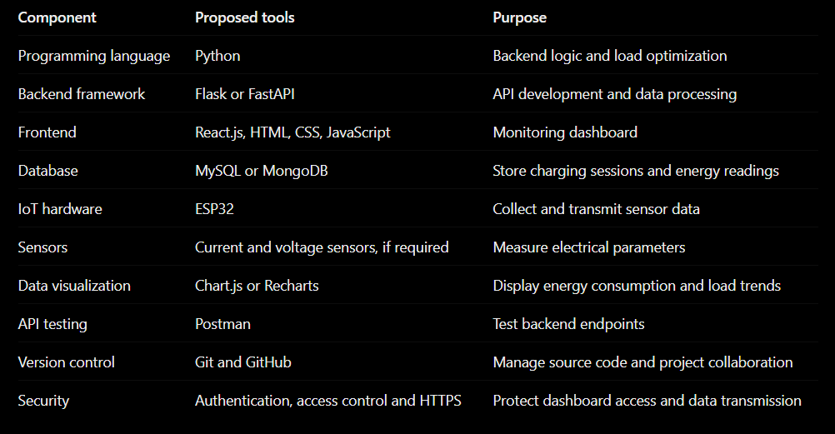
Tools and Technologies Used :

Slide 6
Scope and Future Enhancements :
Project Scope:
The initial version will focus on:
Monitoring multiple simulated or test charging points.
Displaying power consumption and charging status.
Optimizing power distribution within a configured station limit.
Maintaining charging history and energy usage records.
Generating alerts for abnormal readings or offline chargers.
Providing basic authentication and access control.

Slide 7
THANKYOU

